Slide 1
Introduction to Transformer Model
Jiaul Paik
Department of AI
IIT Kharagpur
jiaul@ai.iitkgp.ac.in
© 2026 IITKGP AI4ICPS I Hub Foundation. All rights reserved.

Slide 2
Recap of Necessary Concepts
Projection
Feedforward Neural Net and its matrix form
Softmax
Layer Normalization

Slide 3
Projection and Learning

Slide 4
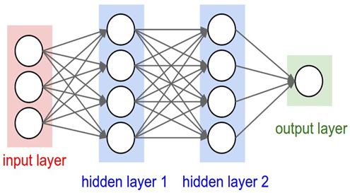
Feedforward Neural Net and its Matrix Form

Slide 5
Softmax

Slide 6
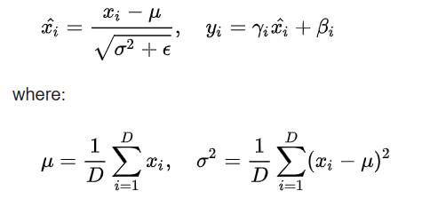
Layer Normalization
For a given data input and layer, it computes the mean and variance
over all the neurons in the layer

Slide 7
What is Transformer?
A Neural network that processes sequential data, understands the context
and performs a set of tasks such as
    Classification
    Translation
    Language Understanding

Slide 8
What is Transformer?
Transformer Network
I like music
me gusta la musica

Slide 9
Transformer Architecture
me gusta la musica
ENCODER
DECODER
Embedding
I like music

Slide 10
Transformer Architecture
me gusta la musica
Encoder 6
Decoder 6
Encoder 5
Decoder 5
Encoder 4
Decoder 4
Encoder 3
Decoder 3
Encoder 2
Decoder 2
Encoder 1
Decoder 1
Embedding
I like music

Slide 11
Encoder Block: Inside Look
Add and normalize
Feedforward Network
Add and normalize
Multi-headed attention
Embedding
I like music

Slide 12
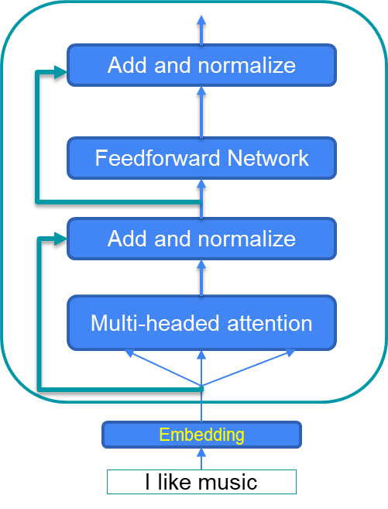
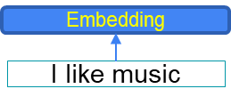
Encoder Block: Multi-headed Attention
Application of self attention mechanism on the input multiple times to generate multiple representation
Output (vectors)
Output (vectors)
Output (vectors)
Output (vectors)
Self attention
Self attention
Self attention
Self attention

Slide 13
Understanding Self-attention
Goal: to understand the relationship between different units (e.g, words) in the input sequence.
input
I love music
Embedding
Queries
Keys
Values

Slide 14
Generating Queries, Keys and Values
Goal: to understand the relationship between different units (e.g, words) in the input sequence.
input
I love music
Embedding
Queries
Keys
Values

Slide 15
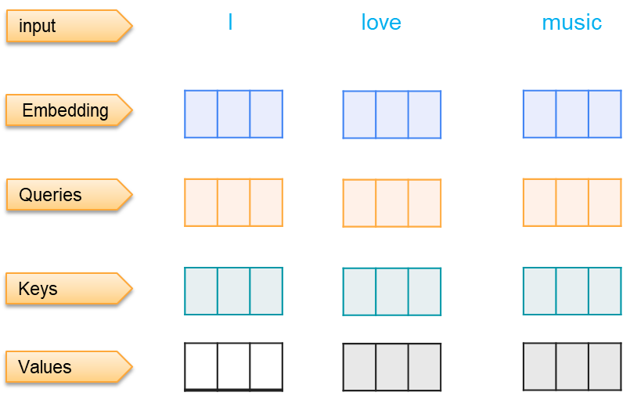

Self-attention: Scaled Dot Product
Goal: to understand the relationship between different units (e.g, words) in the input sequence.
$$Attention\left(Q,K,V\right)=softmax\left(\frac{QK^{T}}{\sqrt{d_{k}}}\right)V$$

Slide 16


Understanding Multi-headed attention
Head 1
Head 2
Head 3

Slide 17


Understanding Multi-headed attention
Head 1
Head 2
Head 3
X

Slide 18
Encoder Block
Add and normalize
Feedforward Network
Add and normalize
Multi-headed attention
Embedding
I like music

Slide 19
Add and Normalize
(Add and normalize)
LayerNormalization
FCNN
FCNN
z1
z2
(Add and normalize)
LayerNormalization(e + v)
v1
v2
Self attention
e1
e2
w1
w2

Slide 20
DECODER

Slide 21
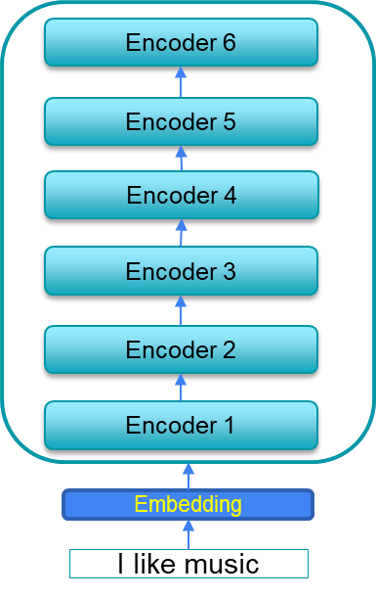
Decoder Block: Inside Look
Add and normalize
Feedforward network
Add and normalize
Multi-headed Cross attention
Add and normalize
Masked multi-headed self attention
Positional encoding of output (right shifted)

Slide 22
Masked Self-attention
Similar to self-attention, but
  Stops positions from attending to subsequent positions
  Words do not get influenced by future tokens (can’t see the future)
  For example, when we are generating “good” in “Life is good”, the masked self attention mechanism will only consider “Life” and “is” to generate “good”.

Slide 23
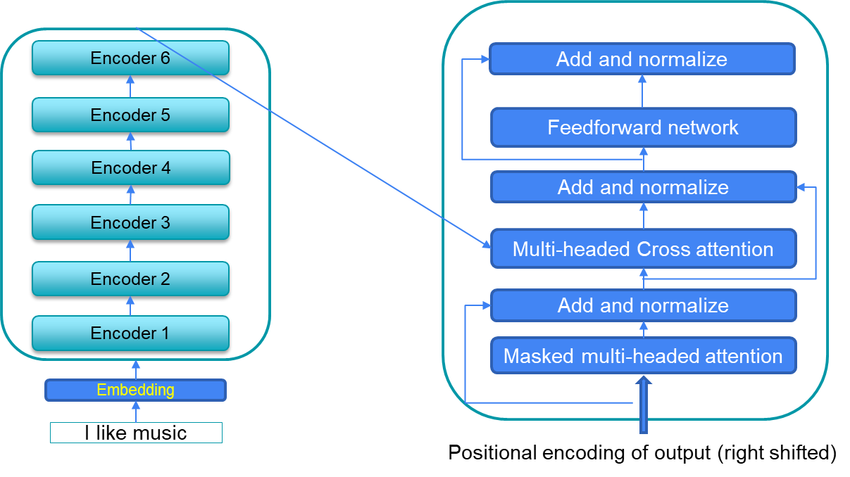

Encoder-decoder attention
Interplay between encoder and decoder
Queries come from the previous decoder layer
Keys and values come from the output of the encoder
$$Attention\left(Q,K,V\right)=softmax\left(\frac{QK^{T}}{\sqrt{d_{k}}}\right)V$$

Slide 25
Positional Encoding

Slide 26
Motivation
Recurrent Networks explicitly takes into account sequential information
But transformers do not

Slide 27
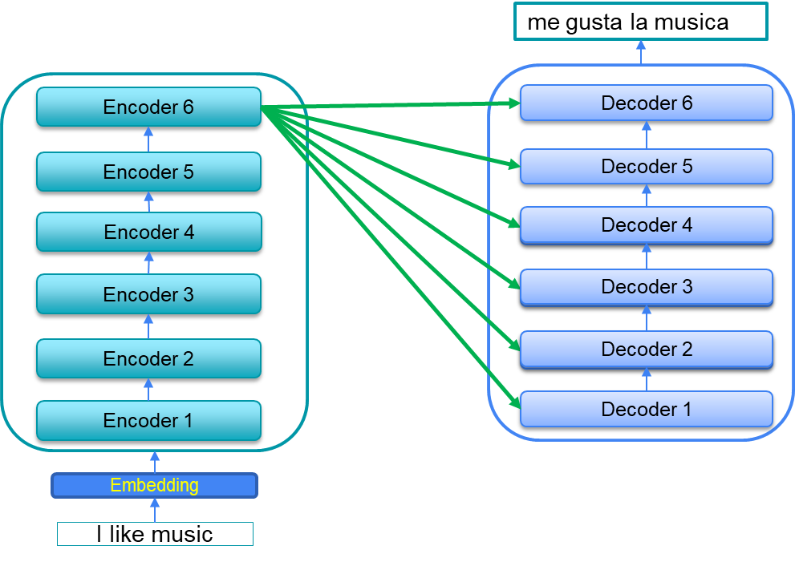
Motivation
Words flow simultaneously through
the encoder/decoder stacks

Slide 28
Properties
Unique positional encoding for each time step
Reasonable notion of relative distance
Independent of sentence size
Deterministic

Slide 29
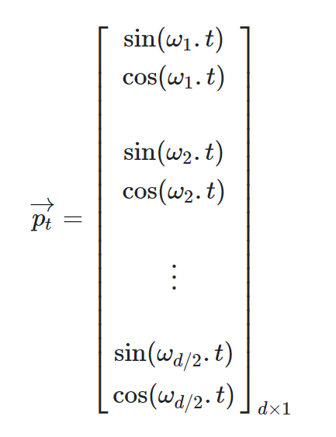
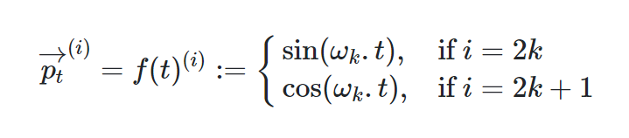
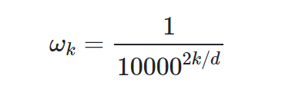
Sinusoidal/Cosinusoidal Positional Embedding
Position will be a vector (instead of scalar)

Slide 30
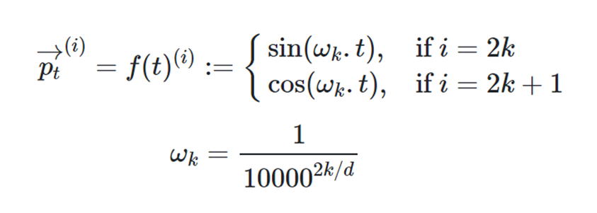
Positional Encoding: Example
Tokens
i
love
music
Index
0
1
2
i=0 | i=0 | i=1 | i=1
Sin(0) | Cos(0) | Sin(0) | Cos(0)

Slide 31
Thank you!

